Slide 1

Cost Analysis
By: Neha Vijay, Aryan Mansharamani, Justin Wohrle, Meshari Aladwani, Preston Watt, Andrew Davey

Slide 2


Our Purpose
KB Homes is a U.S. based homebuilding company that designs and constructs customizable homes to meet the needs of diverse buyers. As a leading industry player operating across many markets, it is essential that the company maintains a precise budget to sustain efficient operations and meet growing demand.
An inaccurate budget could severely impact KB Homes, eroding their ability to manage their costs and maintain profitability. If the budget fails to project expenses or revenues accurately, this can lead to insufficient capital for land acquisition/development, home construction, and delayed projects. This is why my team is here to help with the budgeting process of KB Homes and to explain any variances that might alert management.

Slide 3
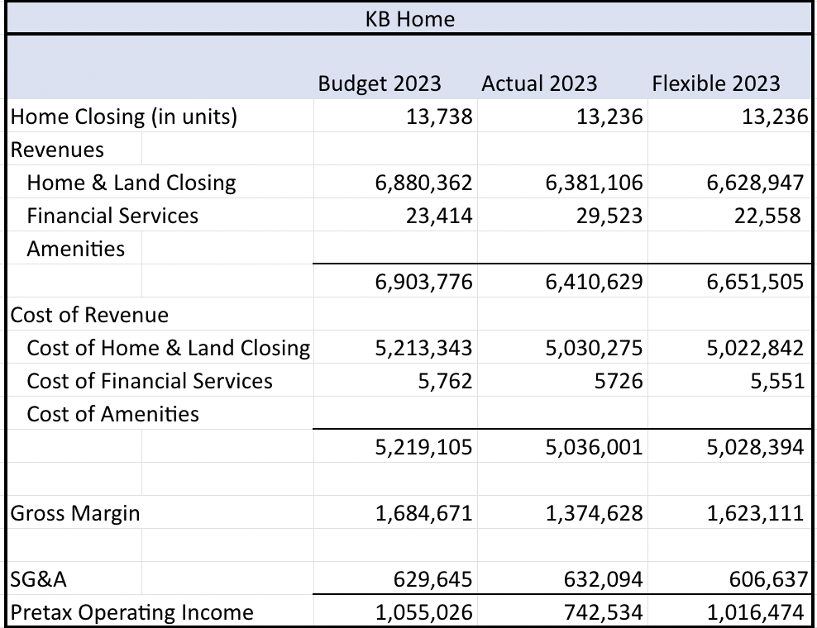
Variances

Slide 4
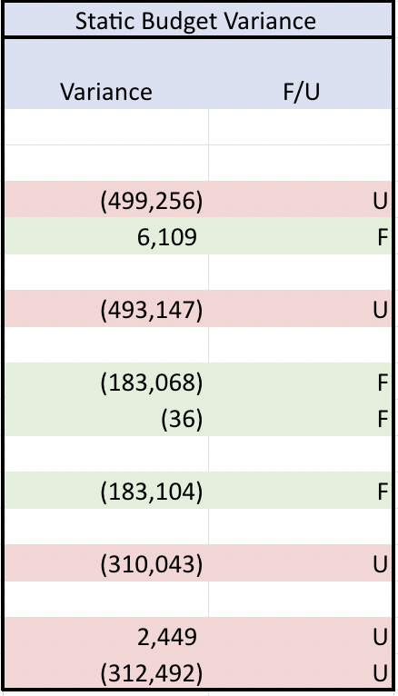
Static Budget Variance
Compared the results of the poorly constructed 2023 budget vs the actual results. The budget made for 2023 was constructed with no strategic goals
Due to actual home closing units being smaller, (4% decrease in the number of homes delivered from 13,738 to 13,236), home/land closing revenue was unfavorable of 499,256. On the other hand, financial services revenue increased and was 6,109 favorable
Overall, the static budget variance had a total that was unfavorable of (312,492)

Slide 5
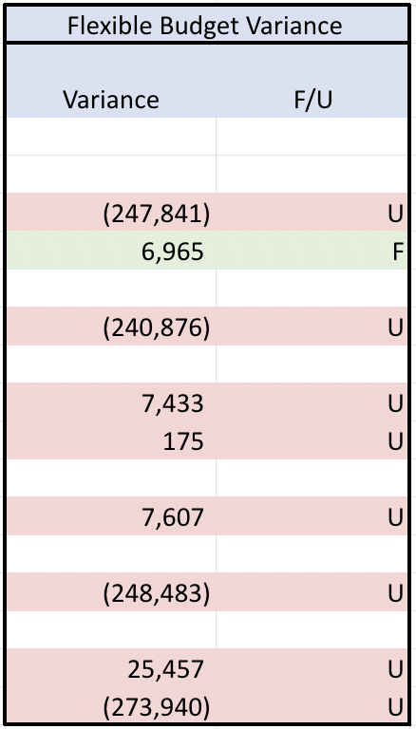
Flexible Budget Variance
Decline in Home Closing Revenue: Unfavorable variance of $247,841 due to a 4% drop in the average selling price to $481,300
Competitive and Economic Pressures: Heightened competition and economic uncertainty led KBH to reduce home prices
Financial Services Growth: Financial services revenue increased by $6,965, driven by higher title services revenue and insurance commissions
Rising Costs: Actual costs for home/land closing and financial services exceeded budgets by $7,607 due to inflation, rising land and construction costs, and lingering supply chain challenges
Higher SG&A Expenses: Selling, general, and administrative (SG&A) expenses rose by $25,457 due to increased marketing and commission costs to support a larger average community count
Overall Unfavorable Variance

Slide 6
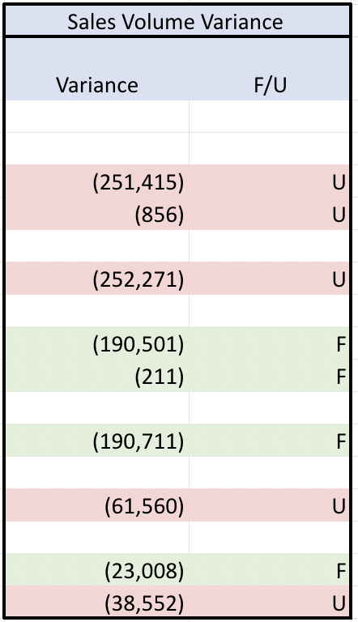
Sales Volume Variance
Sales Volume Variance: Decline in home closings was driven by a 20% decrease in the West Coast segment, partially offset by increases of 4% in the Southwest and Central segments and 2% in the Southeast segment
Impact of Economic Conditions: Rising mortgage rates and inflationary pressures in early 2023 reduced consumer demand for new homes
Supply Chain and Labor Challenges: Ongoing supply chain disruptions and labor shortages slowed construction timelines
Third-Party Dependencies: Cybersecurity incidents at two national title insurers in late 2023 disrupted KB Homes' ability to close land purchases and home transactions, further impacting home delivery volumes
Financial Impacts: The decline in home closings led to $252,271 in unfavorable revenue variance but contributed to a favorable $190,711 cost variance, reflecting reduced expenses tied to lower unit sales
Overall Unfavorable Variance

Slide 7
Unit Sales Budget
X-Variable: Ending Backlog Units
The budget for unit sales includes a regression using ending backlog units as the x-variable, as the number of units in backlog directly influences the ability to close homes.
Result
The forecasted unit sales for 2024 is 10093.83. The regression analysis shows a strong positive relationship between backlog and unit sales.

Slide 8
Home Closing Revenue Budget
X-Variable: US National Home Price Index
The budget for closing revenue includes a regression using the national home price index as the x-variable, as the closing revenue increases or decreases are closely tied to the average home price.
Result
The forecasted home closing revenue for 2024 is 520.54/home or 5,254,242.27 using our forecasted unit sales. The regression analysis shows a strong positive relationship between the home price index and closing revenue with an R-Square of 0.88 and P-Value of 0.005.

Slide 9
Home Closing Costs
X-Variable: Hourly Wages of Construction Workers
The budget for home closing costs includes a regression using Hourly Wages of Construction Workers (Per Statista) as the x-variable, as most of closing costs come from wages paid to construction workers.
Result
Using the equation that was outputted by the regression model and plugging in forecasted Hourly Wages of Construction Workers for 2024 as the x-variable, Home Closing Costs Per Unit are estimated to be $362.44. This is consistent with the trends we've seen in previous years and therefore we deemed it a suitable forecast for 2024.

Slide 10
Selling, General, & Administrative Budget
X-Variable: Sales Revenue
The budget for SG&A expenses includes a regression using sales revenue as the x-variable, as most of SG&A costs come from commissions and other sales-based metrics.
Result
Using the equation that was outputted by the regression model and plugging in forecasted sales revenue for 2024 as the x-variable, SG&A expenses are estimated to be $545,475. As a percentage of revenue, and considering the projected decrease in unit sales, this estimate stays consistent and with prior years at about 10%.

Slide 11
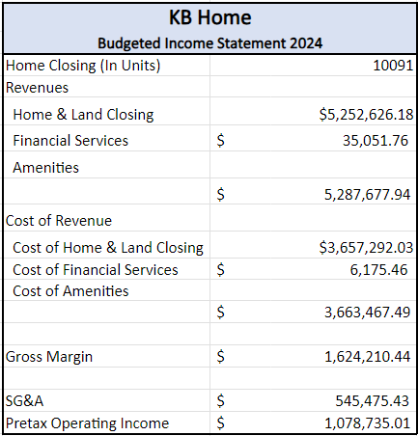
FY2024 Budget
Created based off predicted values calculated by applying previous year values to regression coefficients
Revenues from Financial Services calculated by first calculating average year-on-year (YoY) growth rates and then applying it to 2023 values
Operating income increased regardless of %15 decrease in home closing units
Budget points to a more efficient cost structure and higher average home closing prices per unit
There is a potential for variances due to model limitations
*All values except for Home Closing units are in Thousands

Slide 12
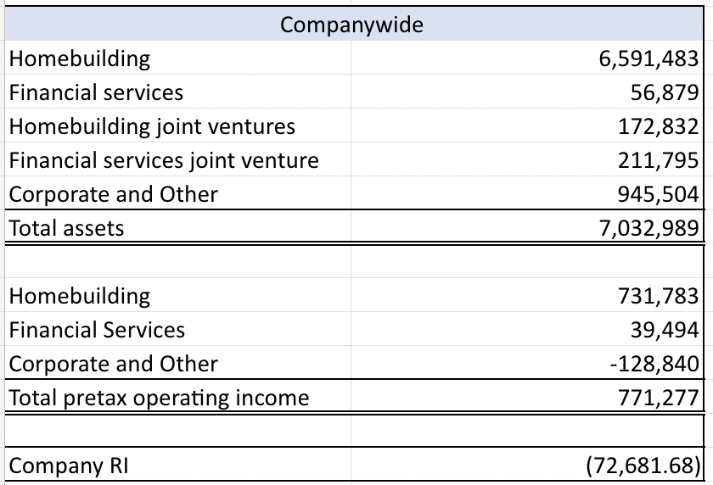
RI
Inaccurate measure as the real estate industry is capital intensive
  Land is recorded as an asset, even if its undeveloped land, land under development, or completed.
  Homes under construction are recorded as assets, this is a heavy amount on their BS as supply chain issues/supplier issues caused them to not finish homes as quickly as possible
  Home builders' own equipment, vehicles, and facilities needed for construction/operations
With this compensation structure, all divisions receive a bonus
  The divisions could be doing worse/slacking off
Recommend to change benchmark to region specific

Slide 13
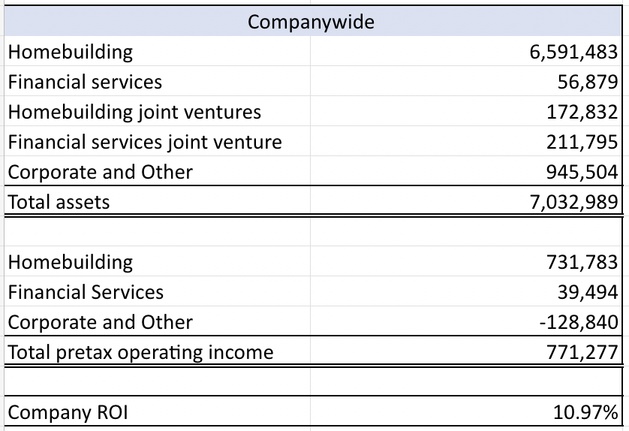
ROI
Southwest, Central, and Southeast would receive a bonus, but the West Division wouldn’t
  West Coast homebuilding reporting engagement had a 20% decrease in the number of homes delivered year over year
  Along with that, the development process in the West Coast home building is typically longer than other segments due to municipal and regulatory requirements that are generally more stringent in California
  Using ROI accurately reflects the company's profitability and all the divisions performance
Recommend company to switch over to ROI

Slide 14
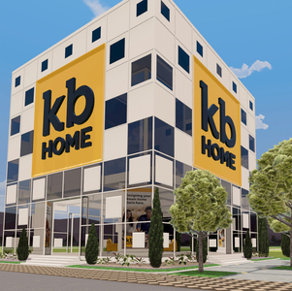
Summary
Unfavorable variances due to decreased number of sales, inflation pressures, and supply chain issues
Unit sales, home closing revenue, home closing costs, and SG&A regression that helped us more accurately create the 2024 budget
Recommend ROI for a performance measure

